Slide 1
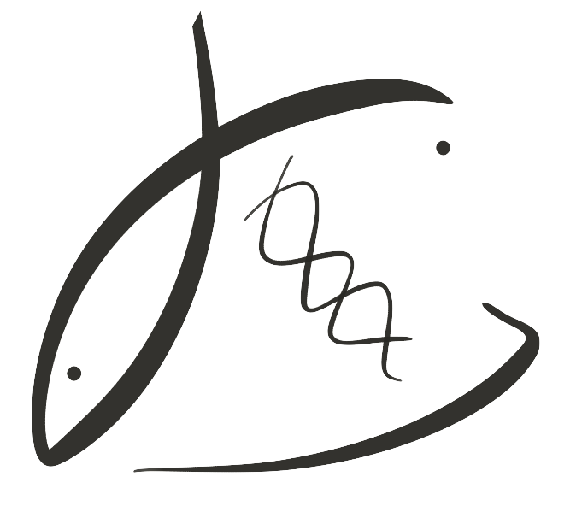
Geoduck as indicators of environmental change
Using proteomics to assess geoduck physiology between environments
Laura H Spencer, UW SAFS
Micah Horwith, WA DNR
Alex Lowe, UW Biology
Emma Timmins-Schiffman & Brook L Nunn, UW Genome Sciences
Sean Bennet & Steven Roberts, UW SAFS
Notes:
Thanks for having me… I’m heading into my 2nd year as a grad student @ UW fisheries. My presentation today is on geoduck, as indicators of environmental change... Where we use proteomics to assess the physiology in geoduck between environments.
The collaborators on project were instrumental .., including folks from …

Slide 2
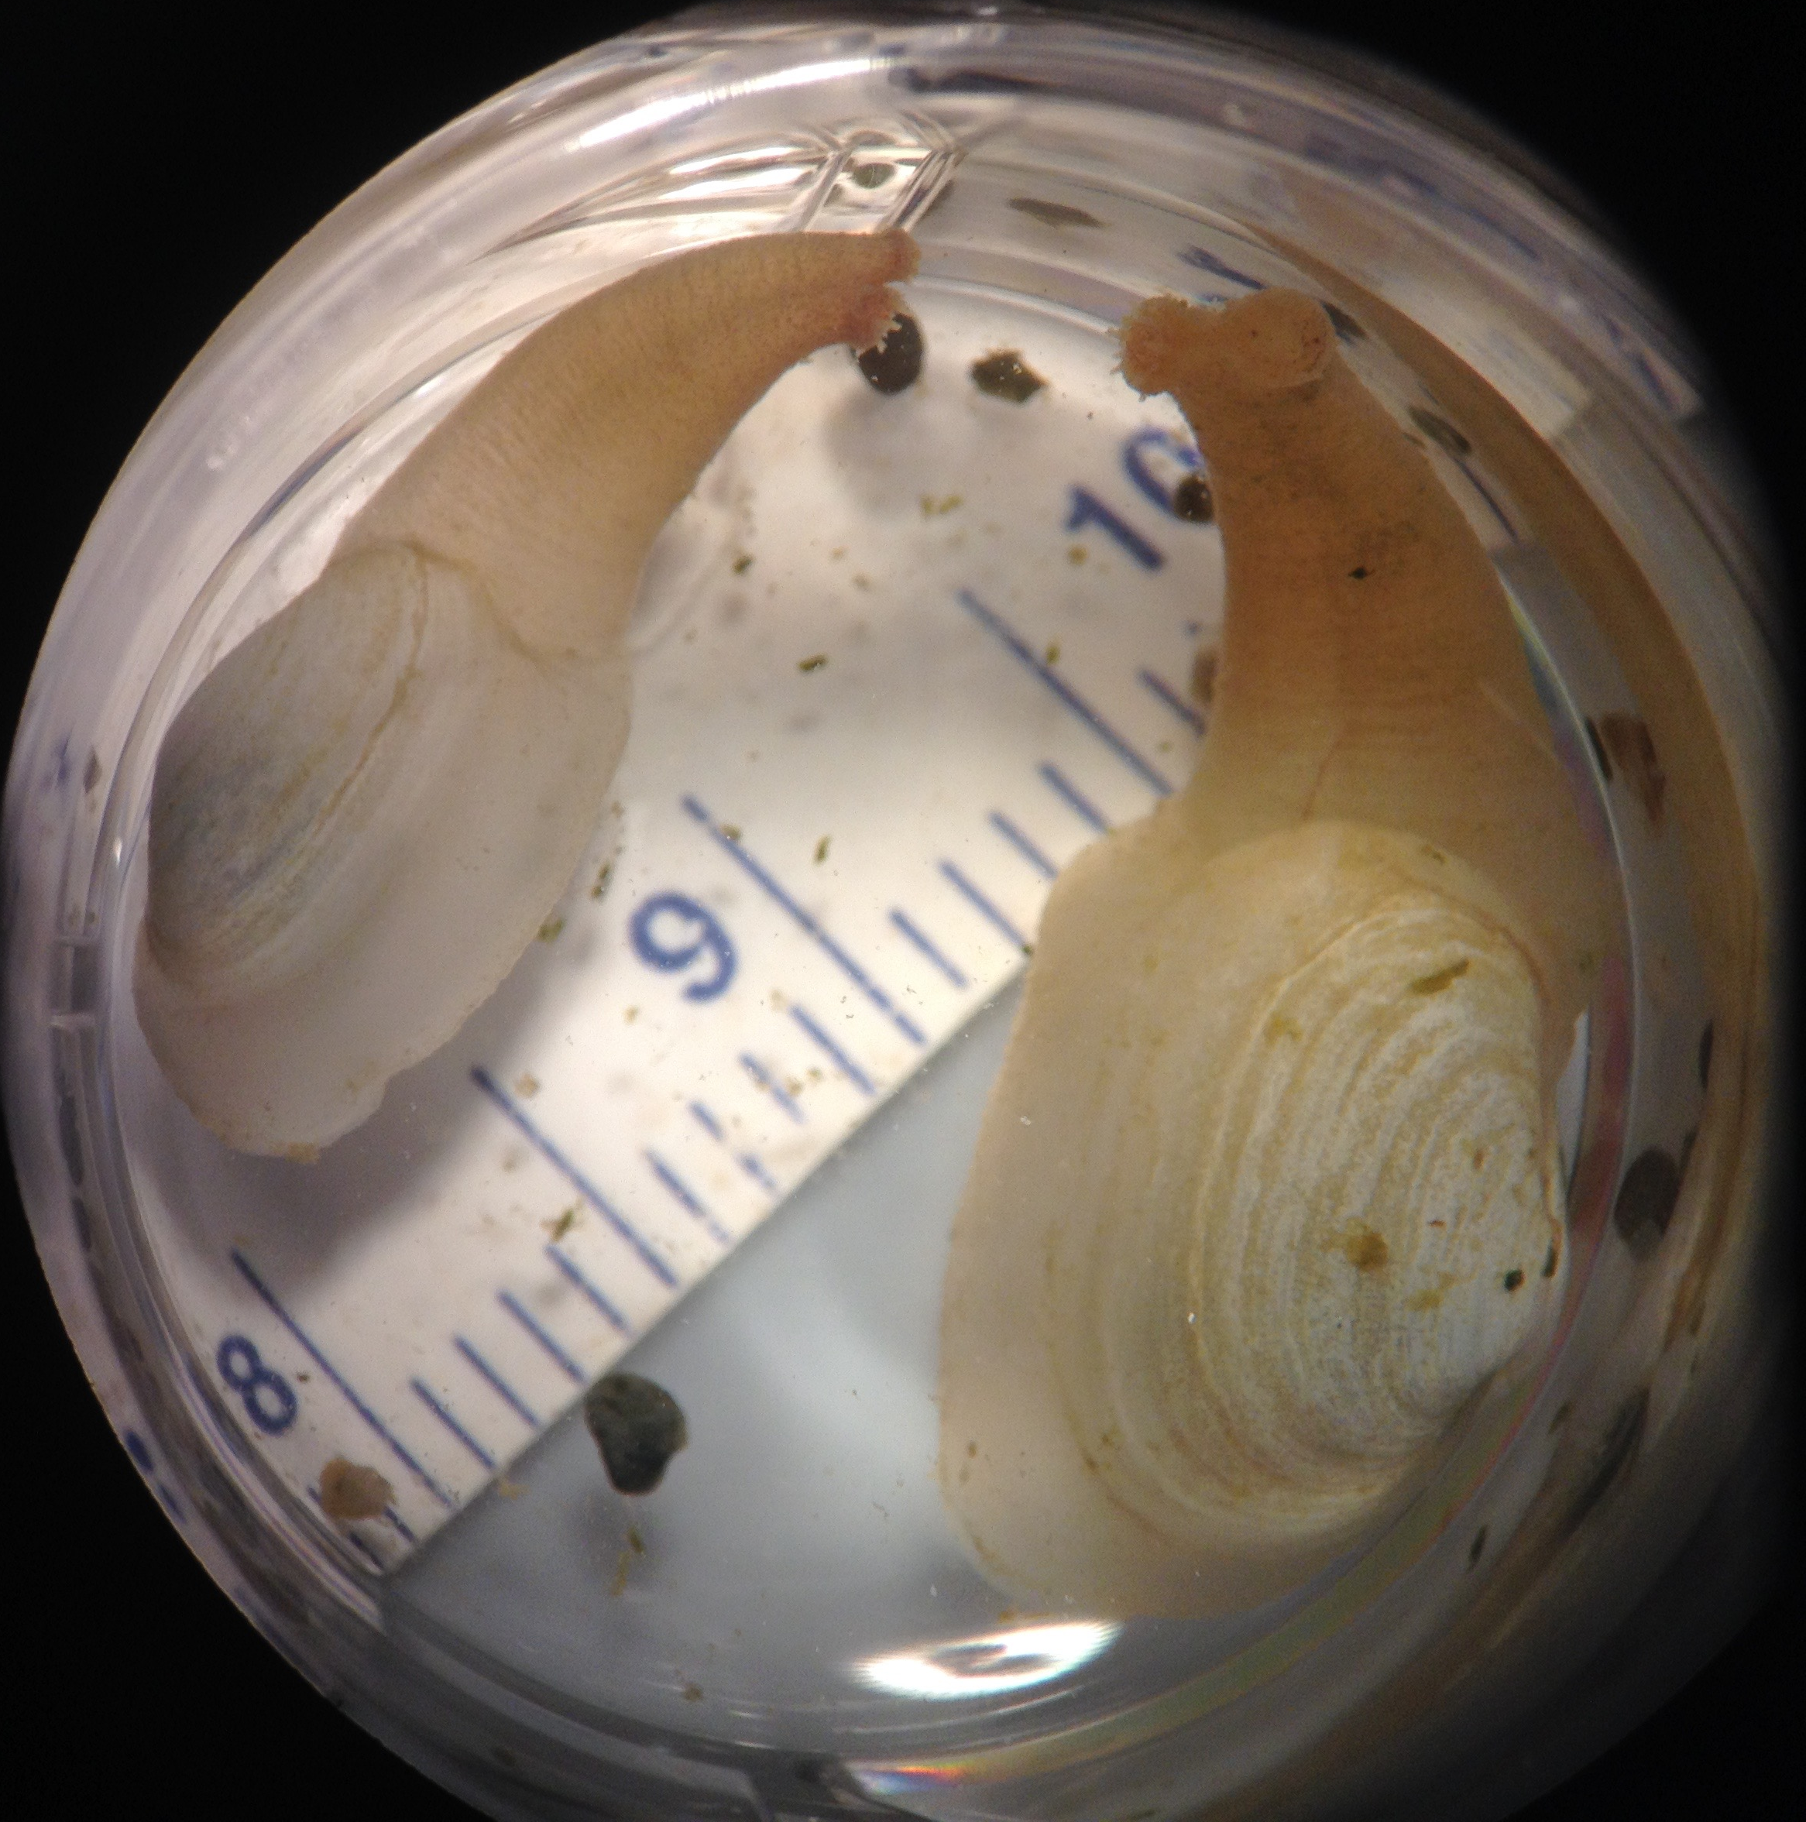
THE GEODUCK Panopea generosa
Native to WA
Largest burrowing clam
Valuable & growing industry
27% WA shellfish aquaculture revenue, ($24.5M in 2013), but only 7% by weight*
*WA Sea Grant report, 2015
Notes:
Pacific geoduck is …
In this growing industry it’s important to know how changes in the environment affects geoduck physiology, whether we are ...
Selecting sites for geoduck aquaculture, or
Predicting the effect of water quality changes on wild and farmed geoduck, or ...
Using Geoduck to monitor the effect of a changing climate on native populations ...
It’s important to know how geoduck respond in different environments.
In this project we use proteomics to assess the physiological response of geoduck in different environments. So... Why proteomics?

Slide 3
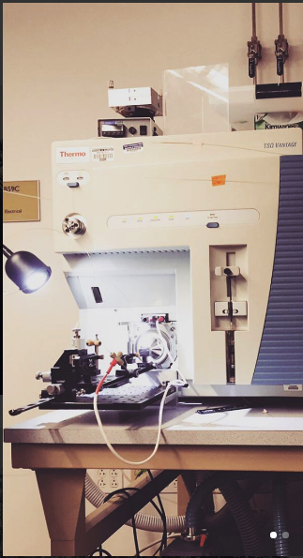
WHY PROTEOMICS?
Proteins…
carry out most cellular activity
change based on environment are dynamic
provide direct measure of physiology, energy allocation
can indicate physiological health status
Notes:
Proteomics is the study of all proteins at the cellular level.
Proteins carry out most cellular activity, and the composition of proteins in the cell can be dynamic, changing based on developmental stage, immune response, and changes in the environment.
Organism experiences a change in temperature, oxygen, etc., certain proteins respond maintain homeostasis, to avoid cell damage
Because these proteins quickly respond to environmental changes, measuring them provide us a direct, sensitive view of the animal’s physiology and energy allocation.
Therefore, we can then measure proteins that we know are triggered by environmental changes, to assess where the animals resources are being directed.

Slide 4
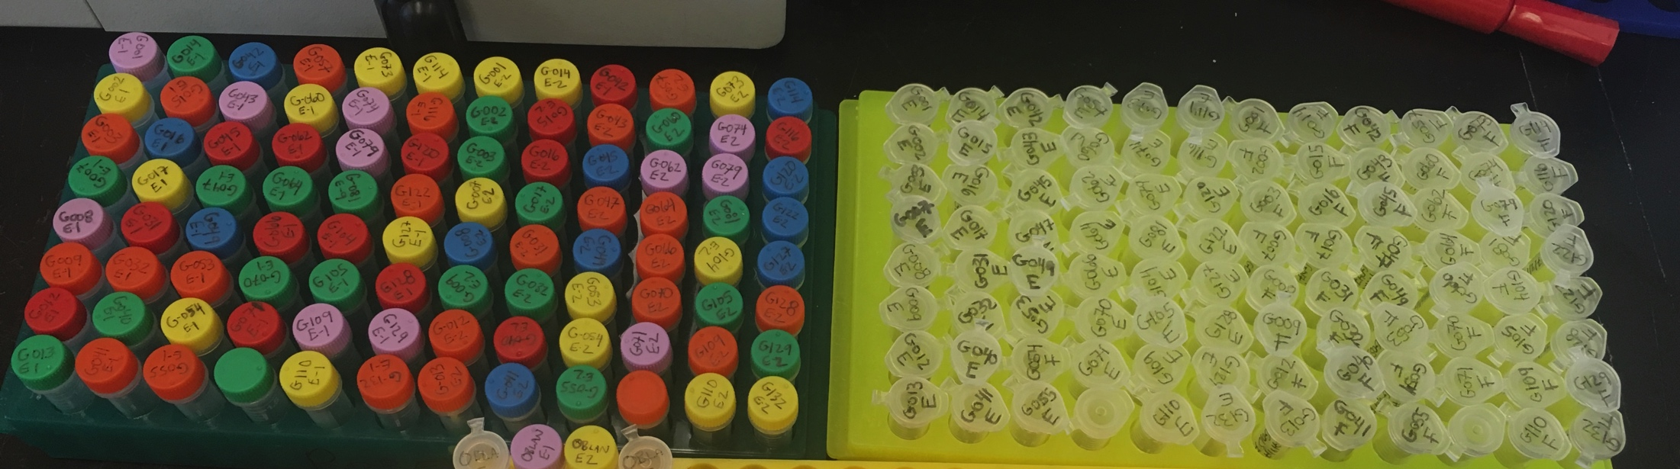
THE QUESTIONS
How does protein abundance differ between geoduck outplanted in different sites?
How do environmental differences correspond to physiological differences?
Which proteins can we use to monitor physiology, assess site suitability in geoduck?
Notes:
In this outplant project, we assess the physiological status in geoduck in different sites. We ask…
First, how does protein abundance differ between geoduck placed at sites around western Washington?
If so, how do environmental differences correspond to geoduck proteins differences, and … ultimately...
Which proteins can we use to monitor geoduck physiology, assess site suitability?

Slide 5
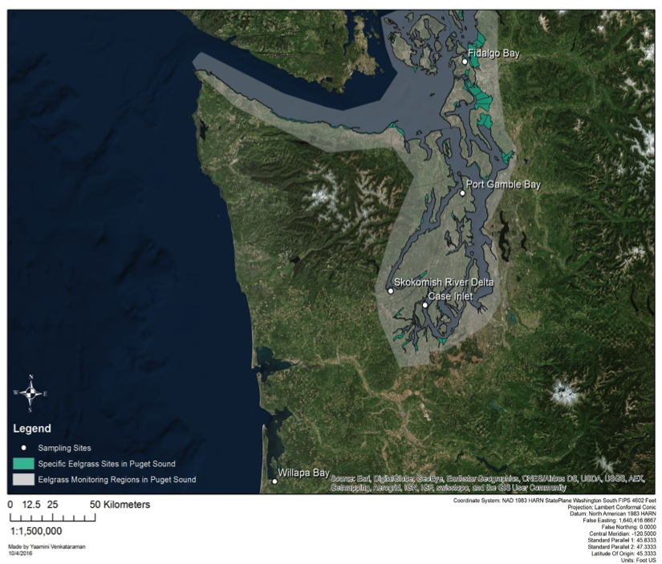
OUTPLANT: 4 sites, Puget Sound & Willapa Bay
Fidalgo Bay
Sibling juvenile geoduck
Duration = 1 month
Port Gamble Bay
Case Inlet
Willapa Bay
Notes:
As mentioned, this was an outplant study.
Sibling juvenile geoduck were split into 4 groups, and outplanted in throughout Washington for one month, from June to July.
3 sites spanned Puget Sound from north to south, and one site was in Willapa Bay.
Each site also included 2 habitats, eelgrass beds and bare sediment.
Placed a suite of probes at each site to monitor water quality
At end of month sampled the animals for gill tissue, & extracted proteins

Slide 6
Protein analysis in 2-phases
PHASE I
Protein Discovery
PHASE II
Targeted Protein Quantification
8 samples
2 per site
48 samples
12 per site
Captured all proteins
Measured 8,076
targeted 13 proteins
Identified 5,690 proteins via transcriptome
Quantified abundance
Selected proteins based on:
Detectability
Quality
Biological Function
Assessed similarity
between sites
Notes:
We measured protein composition in 2 phases, both using a mass spectrometer.
Phase 1: on left
Discovery phase, where we determine which proteins we can clearly measure in our gill tissue?
Aka: Shotgun Proteomics
Highly memory intensive, limited by the number of sample we can process.
Ran 2 geoduck samples per site, measured total of ~8k proteins, and ID’d 5,700.
From 5,700 known proteins we selected a handful to investigate further.
Proteins selected based on detectability across all samples, quality of signal, and biological function.
Phase 2: on right
Targeted quantification phase, we can precisely measure the amount of each proteins we’ve selected in each geoduck sample.
Less intensive, ran 12 per site, targeting 13 proteins
The data we collected from phase 2 was quantity data, and were able to compared abundance between sites.

Slide 7
Proteins selected for Phase 2
PROTEIN | Response to…
Heat Shock Protein 90-alpha | General Stress
Heat Shock Protein 70 | General Stress
Superoxide Dismutase | Oxidative stress
Catalase | Oxidative stress
Peroxiredoxin-1 | Oxidative stress
Puromycin-sensitive aminopeptidase | Oxidative stress
Protein disulfide-isomerase | Oxidative stress
Ras-related protein Rab-11B | Acidic pH
Sodium/Potassium-transporting ATPase subunit alpha | pH changes
Glycogen Phosphorylase (muscle form) | Carbohydrate metabolism
Trifunctional enzyme subunit beta (mitochondrial) | Lipid metabolism
Cytochrome P450 | Toxins
Arachidonate 5-lipoxygenase | Inflammation
Notes:
This is the list of 13 proteins that I selected for phase 2.
I focused on proteins triggered by environmental changes, such as general stress response proteins, oxidative stress or pH changes
Again, these were also selected b/c had a very clear signal in all phase 1 samples, a good sign that we could consistently measure them again.
With the abundance data for these 13 proteins, we can see if there are any patterns in geoduck placed in our four sites.

Slide 8
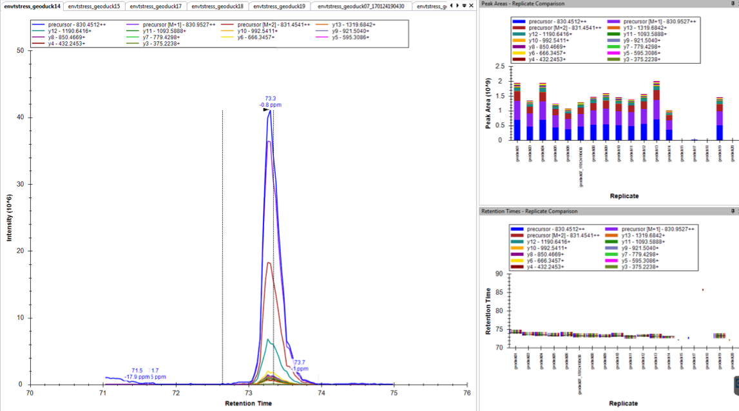
Selected proteins have strong, clear signal
gigasin
Poor quality
Good quality
Heat Shock Protein 70
Notes:
In case I need this info:

Slide 9
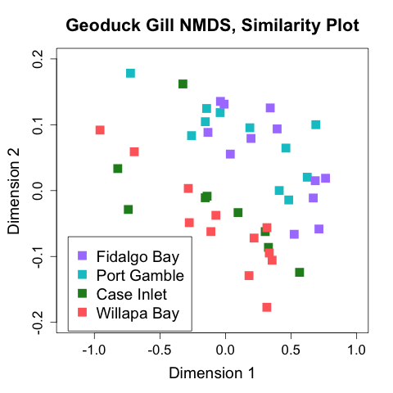
Results Site Difference, all proteins ANOSIM, P=0.03
Fidalgo Bay
Port Gamble
Case Inlet
Willapa Bay
Notes:
On the left is an NMDS plot, (NMDS), which allows us to visualize patterns in our abundance data.
On this plot, each point represents a geoduck sample
Points are color coded by site
Closer points are to each other, more similar the abundances are for the 13 proteins.
If there was no difference between geoduck placed at different site, the colors would be all mixed together,
But we see a clear clustering by site, and a geographical separation, where the northern-most sites (FB, PG) are more similar to each other than they are to the southern sites (CI, WB). This site difference is confirmed with an analysis of similarity test, P=.03.

Slide 10
Results Site Differences, per protein
PROTEIN | Response to… | ANOSIM P-Value
Heat Shock Protein 90-alpha | General Stress | 0.023
Heat Shock Protein 70 | General Stress | 0.000050
Superoxide Dismutase | Oxidative stress | 0.89
Catalase | Oxidative stress | 0.75
Peroxiredoxin-1 | Oxidative stress | 0.41
Puromycin-sensitive aminopeptidase | Oxidative stress | 0.56
Protein disulfide-isomerase | Oxidative stress | 0.029
Ras-related protein Rab-11B | Acidic pH | 0.82
Sodium/Potassium-transporting ATPase subunit alpha | pH changes | 0.64
Glycogen Phosphorylase (muscle form) | Carbohydrate metabolism | 0.70
Trifunctional enzyme subunit beta | Lipid metabolism | 0.089
Cytochrome P450 | Toxins | 0.81
Arachidonate 5-lipoxygenase | Inflammation | 0.42
Notes:
We then compare abundance data for each protein individually, and find that WHEN GROUPED by SITE three proteins are significantly different (highlighted in red).
All three involved in re-folding of denatured, or unfolded proteins, & assisting in degradation of overly damaged proteins.
Heat Shock protein is a misnomer; production is triggered by heat shock, but it is also produced in response to other stressors that also cause damage and unfolding of proteins.

Slide 11
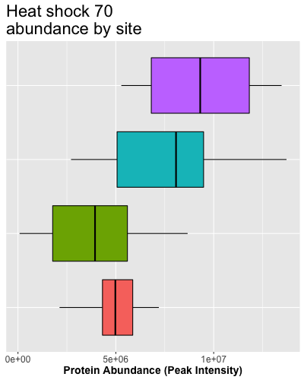
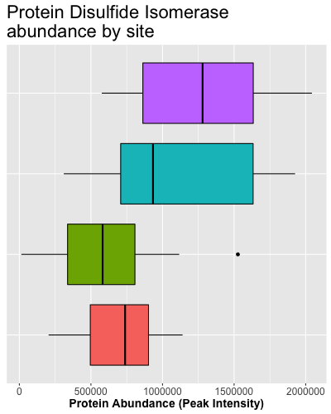
Results Stress proteins higher in FB, PG
N
S
Fidalgo
Port Gamble
Case Inlet
Willapa
Notes:
We found geoduck at different sites have different amounts of 3 proteins related to stress response. But at which sites are they producing more? This is a box plot for HSP90.
The X axis is abundance
Boxes are organized by latitude along the Y.
We again see a geographical pattern, where FB & PGB to the north have higher levels of the stress protein.
This pattern is consistent across all three proteins.
What’s interesting is how the environmental data compare.
This is a bar plot of the mean DO data over the month at each site. DO is higher in northern sites, where stress protein is higher.
Similarly, pH is much lower in the northern sites
A recorded mean pH of 7.1 is indeed very low, with historic levels in Puget Sound in the high 7’s (e.g. 7.8 @ Ken Chew)
Low pH can cause high levels of reactive oxygen species, or free radicals, causing oxidative stress and cell damage.
Similarly, DO of 12 & 14.5 at the northern sites would be highly over-saturated, 100% saturation would be near 9ppm.
SUPER-saturation of DO can also resulting in cellular oxidative stress.
Laboratory studies do show this type of damage as a result of low pH and supersaturated oxygen.
Perhaps these 2 factors are having a compounding effect, and resulting cellular damage, triggering production of stress response proteins.
HOWEVER: outplant studies- other factors could cause damage (e.g. chemical toxins).
REGARDLESS, THIS DATA INDICATES geoduck @ PG&FB pooling more energy into producing stress proteins, thus having less energy for processes like growth, immune system, and this correlates to acidic, and oxygen supersaturated water.

Slide 12
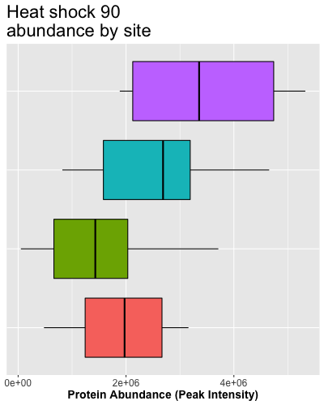
Results Stress proteins and pH, DO
N
Geographic pattern
Highest abundance in North
Lowest abundance in South
S
Fidalgo
Port Gamble
Case Inlet
Willapa
Notes:
We found geoduck at different sites have different amounts of 3 proteins related to stress response. But at which sites are they producing more? This is a box plot for HSP90.
The X axis is abundance
Boxes are organized by latitude along the Y.
We again see a geographical pattern, where FB & PGB to the north have higher levels of the stress protein.
This pattern is consistent across all three proteins.
What’s interesting is how the environmental data compare.
This is a bar plot of the mean DO data over the month at each site. DO is higher in northern sites, where stress protein is higher.
Similarly, pH is much lower in the northern sites
A recorded mean pH of 7.1 is indeed very low, with historic levels in Puget Sound in the high 7’s (e.g. 7.8 @ Ken Chew)
Low pH can cause high levels of reactive oxygen species, or free radicals, causing oxidative stress and cell damage.
Similarly, DO of 12 & 14.5 at the northern sites would be highly over-saturated, 100% saturation would be near 9ppm.
SUPER-saturation of DO can also resulting in cellular oxidative stress.
Laboratory studies do show this type of damage as a result of low pH and supersaturated oxygen.
Perhaps these 2 factors are having a compounding effect, and resulting cellular damage, triggering production of stress response proteins.
HOWEVER: outplant studies- other factors could cause damage (e.g. chemical toxins).
REGARDLESS, THIS DATA INDICATES geoduck @ PG&FB pooling more energy into producing stress proteins, thus having less energy for processes like growth, immune system, and this correlates to acidic, and oxygen supersaturated water.

Slide 13
Results Stress proteins and pH, DO
N
S
Fidalgo
Port Gamble
Case Inlet
Willapa
Notes:
We found geoduck at different sites have different amounts of 3 proteins related to stress response. But at which sites are they producing more? This is a box plot for HSP90.
The X axis is abundance
Boxes are organized by latitude along the Y.
We again see a geographical pattern, where FB & PGB to the north have higher levels of the stress protein.
This pattern is consistent across all three proteins.
What’s interesting is how the environmental data compare.
This is a bar plot of the mean DO data over the month at each site. DO is higher in northern sites, where stress protein is higher.
Similarly, pH is much lower in the northern sites
A recorded mean pH of 7.1 is indeed very low, with historic levels in Puget Sound in the high 7’s (e.g. 7.8 @ Ken Chew)
Low pH can cause high levels of reactive oxygen species, or free radicals, causing oxidative stress and cell damage.
Similarly, DO of 12 & 14.5 at the northern sites would be highly over-saturated, 100% saturation would be near 9ppm.
SUPER-saturation of DO can also resulting in cellular oxidative stress.
Laboratory studies do show this type of damage as a result of low pH and supersaturated oxygen.
Perhaps these 2 factors are having a compounding effect, and resulting cellular damage, triggering production of stress response proteins.
HOWEVER: outplant studies- other factors could cause damage (e.g. chemical toxins).
REGARDLESS, THIS DATA INDICATES geoduck @ PG&FB pooling more energy into producing stress proteins, thus having less energy for processes like growth, immune system, and this correlates to acidic, and oxygen supersaturated water.

Slide 14
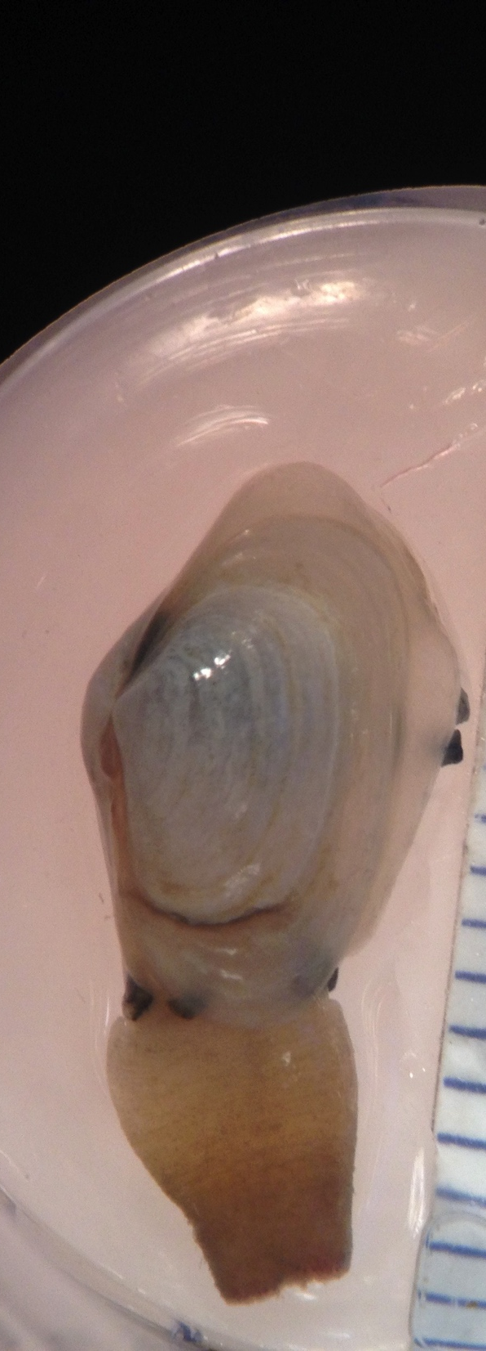
Conclusions & Next Steps
Findings
Clear physiological differences between sites
Geographic pattern: more stress proteins in northern sites
Correlation with low pH, high DO, possibly due to oxidative stress
Next steps
Longer outplant with growth & reproduction data
Re-run samples with different targets
Assess proteins for use as site suitability assays
Notes:
Overall:
Remarkable that sibling geoduck, separated for 1 month, have clear physiological differences between sites, measured in three stress-related proteins
There is a geographical pattern, where geoduck placed in northern sites produced more stress-proteins, correlated with lower pH and higher DO
More Next Steps:
(Gill transcriptome, can use to more accurately ID the 8k proteins.)
Ultimate goal: could use these proteins for short-term site-assessment outplants : placed a few geoduck @ different locations, ID which is best for aquaculture

Slide 15




Thank you…
Emma Timmins-Schiffman & the rest of the Brook Nunn lab, UW Genome Sciences
Micah Horwith, WA Department of Natural Resources
Alex Lowe, UW Biology
Yaamini Venkataraman, Jose Guzman, Grace Crandall, Sean Bennet, Steven Roberts, UW SAFS
This work is supported by NSF GRFP
Notes:
Benefits of 2-phase proteomics
Why not use other method of measuring proteins?
Phase 1 – the memory-intensive step- is only required once, and results can be used again. I now have 8k proteins detected, and anyone could use as targets for future studies.
Phase 2 is inexpensive; depending on the # of target proteins, cost could be $20-$50 per sample
This 2-phase allows us to potentially ID unexpected proteins
Works with new species once transcriptome is available; doesn’t have to be tissue-specific.
Proteomic response to elevated PCO2 level in eastern oysters, Crassostrea virginica: evidence for oxidative stress, Lars Tomanek etc., 2011
Low pH and ROS, all investigated in mammals:
High pCO2 series of reactions to form ROS
“Low intracellular pH triggered by environmental acidification may negatively affect the efficiency of the mitochondrial electron transport chain (ETC) by increasing electron slip in ROS-generating mitochondrial … would result in elevated rates of ROS generation.”
Low pH can cause a release of transition metals, such as iron, which can oxidize molecules and cause oxidative stress
Marcelo Hermes-Lima, Tania Zenteno-Savın (Brazil), 2002, Animal response to drastic changes in oxygen availability and physiological oxidative stress
OXIDATIVE STRESS IN VERTEBRATES AND INVERTEBRATES: Molecular Aspects of Cell Signaling: Mr & Mrs. Farooqui, The Ohio State – textbook on oxidative stress, touches on various causes due to differing oxygen levels.
COST: Need exact number.
$300/day, 7 days (including dilution curve etc. & some extra time), + extraction kit cost

